Slide 1
Auction Based- Internet Advertising Platform Name : Vishwa Shah NUID : 001712672

Slide 2
Problem Statement
In Online Internet Auction world, the advertisers bid for placing their ad on the publishers page, when the consumer clicks on that page.
. Each advertiser have their own bidding model for setting the bidding price based on the consumer’s browsing history. The Bidding takes place through Ad Exchange.
The highest bidder from the list of advertisers taking part wins the bid and that advertiser’s ad is placed on the publisher’s page.

Slide 3
The cost of advertising is calculated on the basis of the compensation model. There are two compensation model for Display Advertising. Cost per Click (CPC) and Cost per Impression (CPM). In my project, I have used Cost per Impression (CPM) model.
The problem here is the auction that takes place at the moment of click. The process takes place in just a few milliseconds. The advertiser should come up with a bidding model that helps them in setting the bid price that is effective and profitable.

Slide 4
Solution
The Marketing Organization of Advertiser Enterprise first prepares the bidding model which includes prices for certain parameters like if the interest of the consumer matches with the field of the enterprise.
The Consumer logs in creates its browsing history and clicks on the publisher’s webpage. The consumer’s profile is sent to the publisher, who in turn decides the reserve price for the auction based on the browsing history of the consumer.
The publisher then sends request to Ad Exchange for taking auction along with consumer’s browsing history, Ad Space Dimensions of the Ad Space that is in the webpage clicked by the consumer.

Slide 5
AdExchange notifies all the marketer’s of the Advertising Company about the available Ad Space along with consumer history.
All marketer’s decide whether to bid for the space and then bid for it according to the bidding model set by them.
Ad Exchange selects the highest bidder and notifies the publisher about the winner. The Ad Space is assigned to the winner’s advertisement.
Publisher then generates bill according to the Cost Per Impression Compensation Model.

Slide 6
Cost Per Impression
Cost Per Impression Model is where advertiser’s pay each time an ad is displayed. It is the cost or expense incurred for marketing potential customers who view the advertisement.

Slide 7
Object Model
https://dochub.com/vishwashah38a8c63a/eQ1zn/object-diagram-1

Slide 8
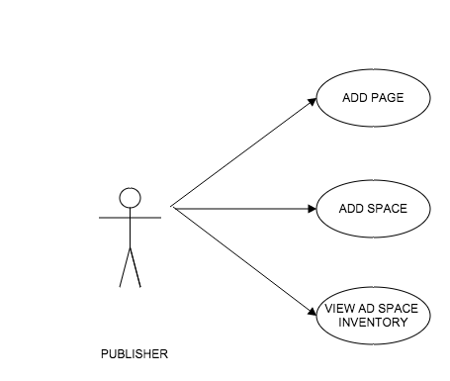
Use Cases
Publisher

Slide 9
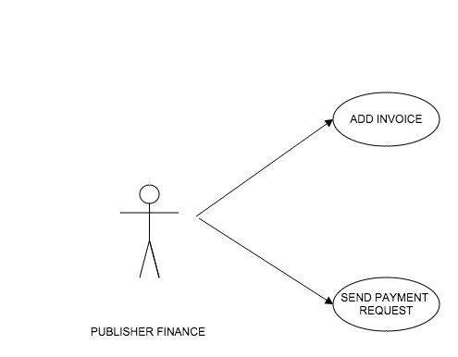
Publisher Finance

Slide 10
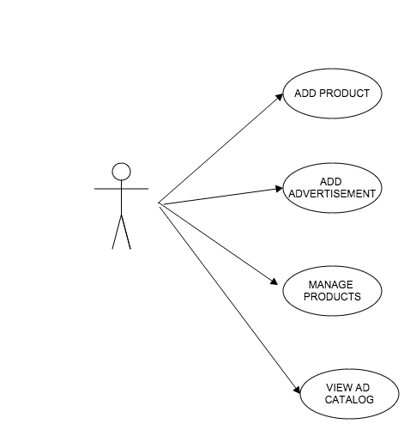
Advertiser

Slide 11
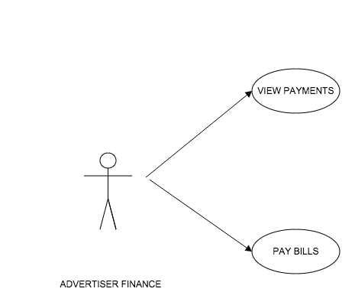
Advertiser Finance

Slide 12
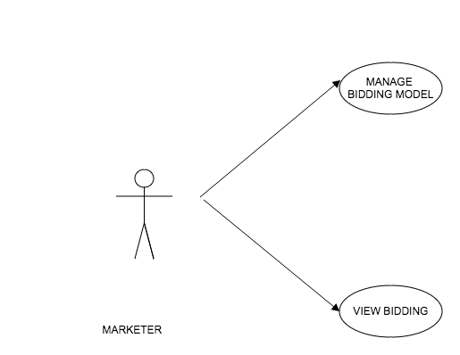
Marketer

Slide 13
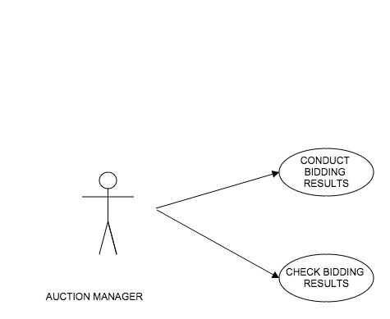
Auction Manager

Slide 14
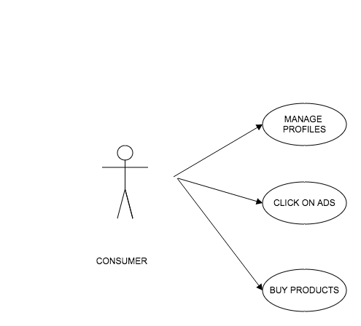
Consumer

